Slide 1
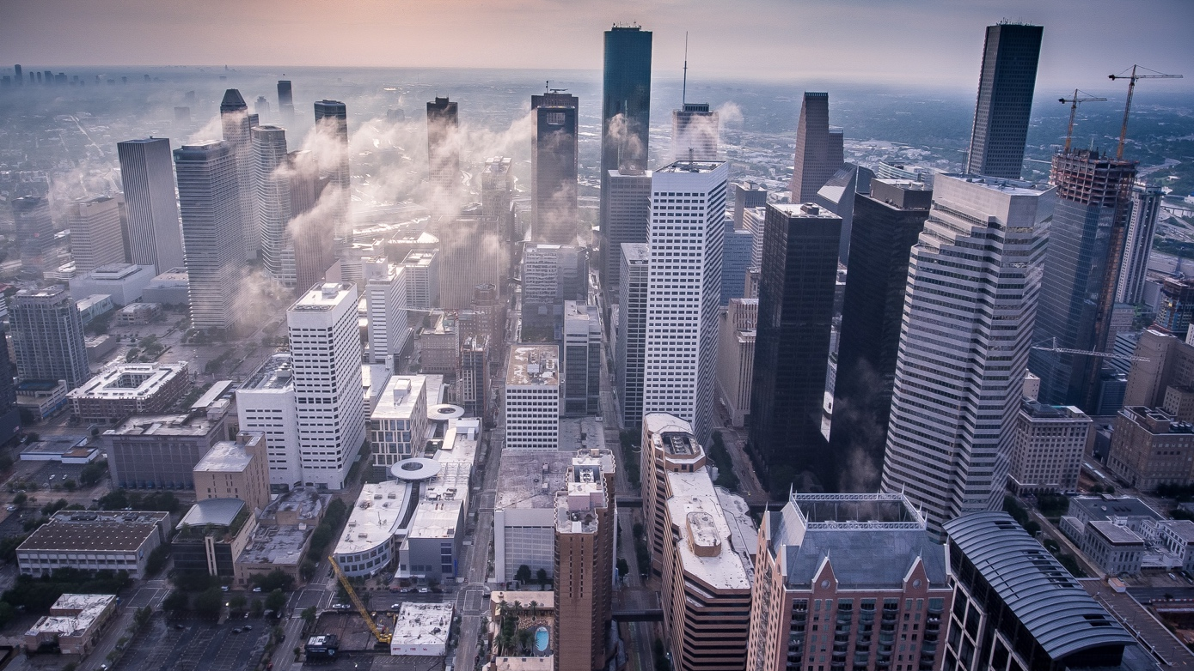
Project: Neighborhoods in Houston
Robin Chriqui

Slide 2
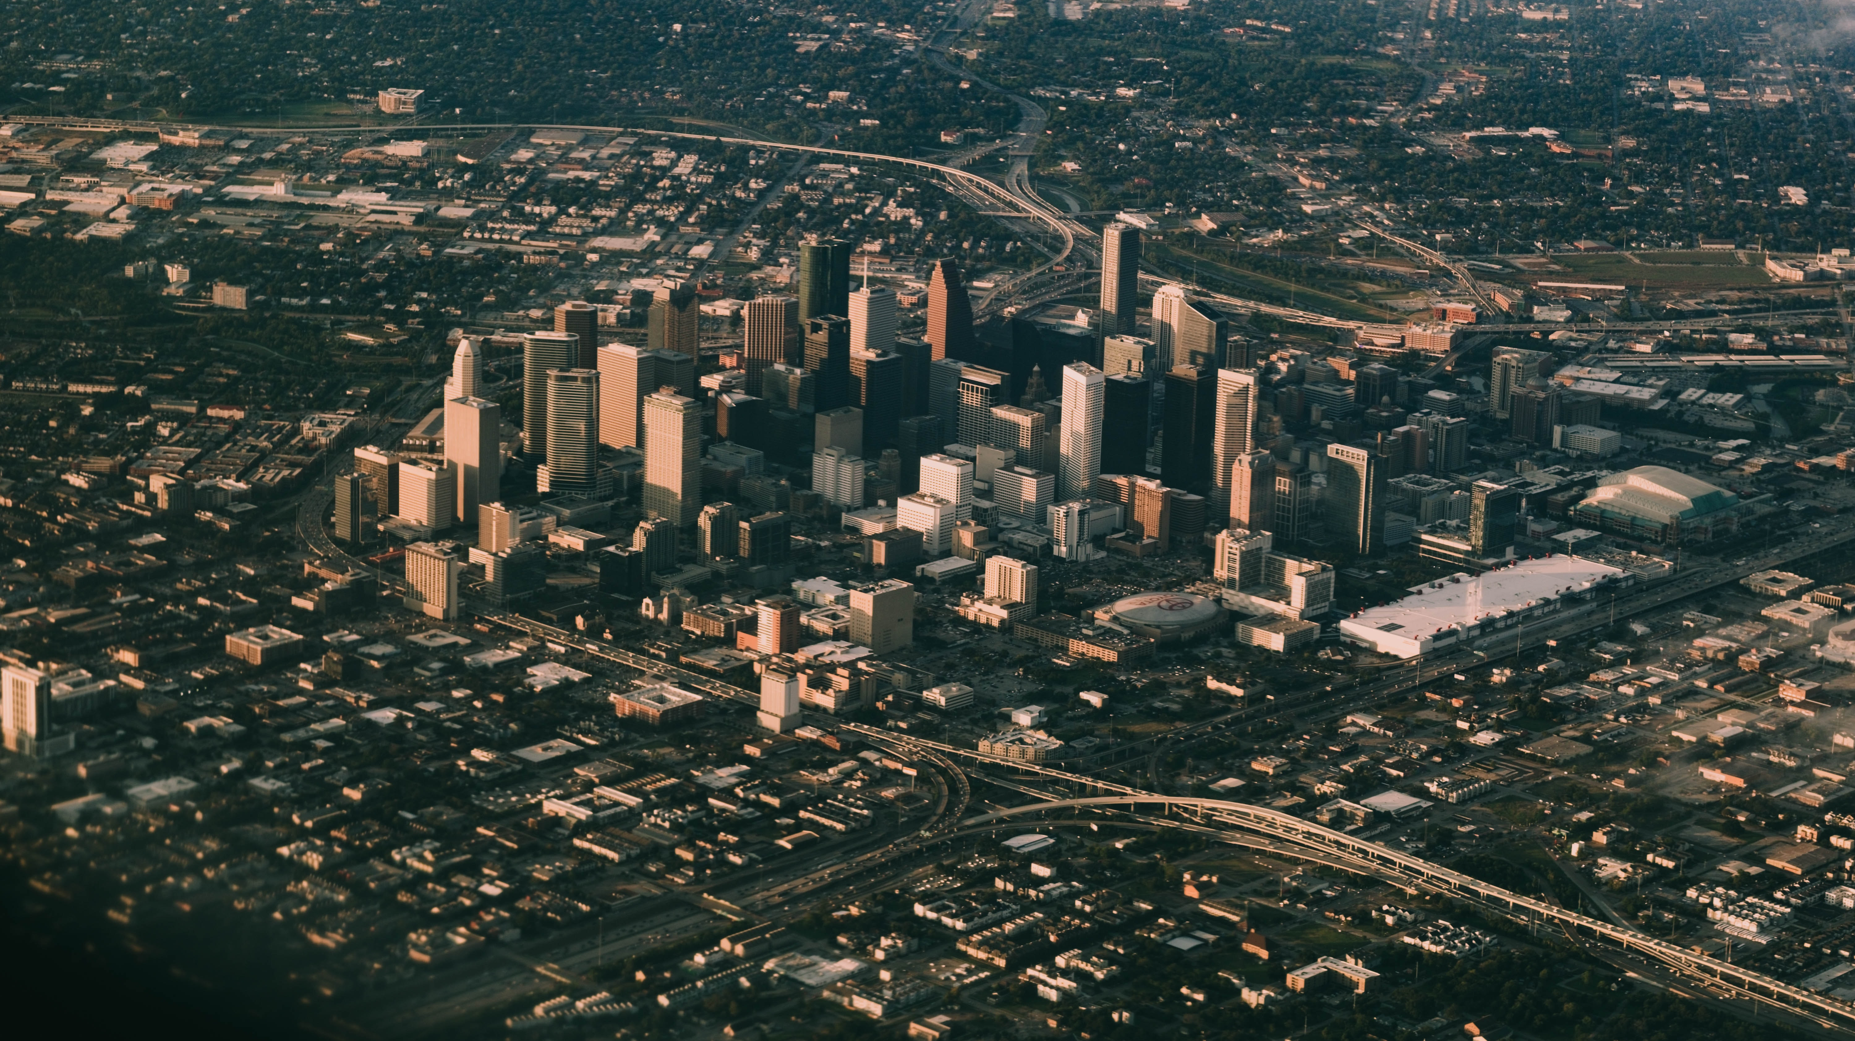
Houston
Most populated city in the US state of Texas with 2.3 millions of residents
High ethnic diversity(37% Anglo, 36% Hispanic, 17% African American)
A major touristic placeHouston received approximately 17.5 million visitors in 201

Slide 3
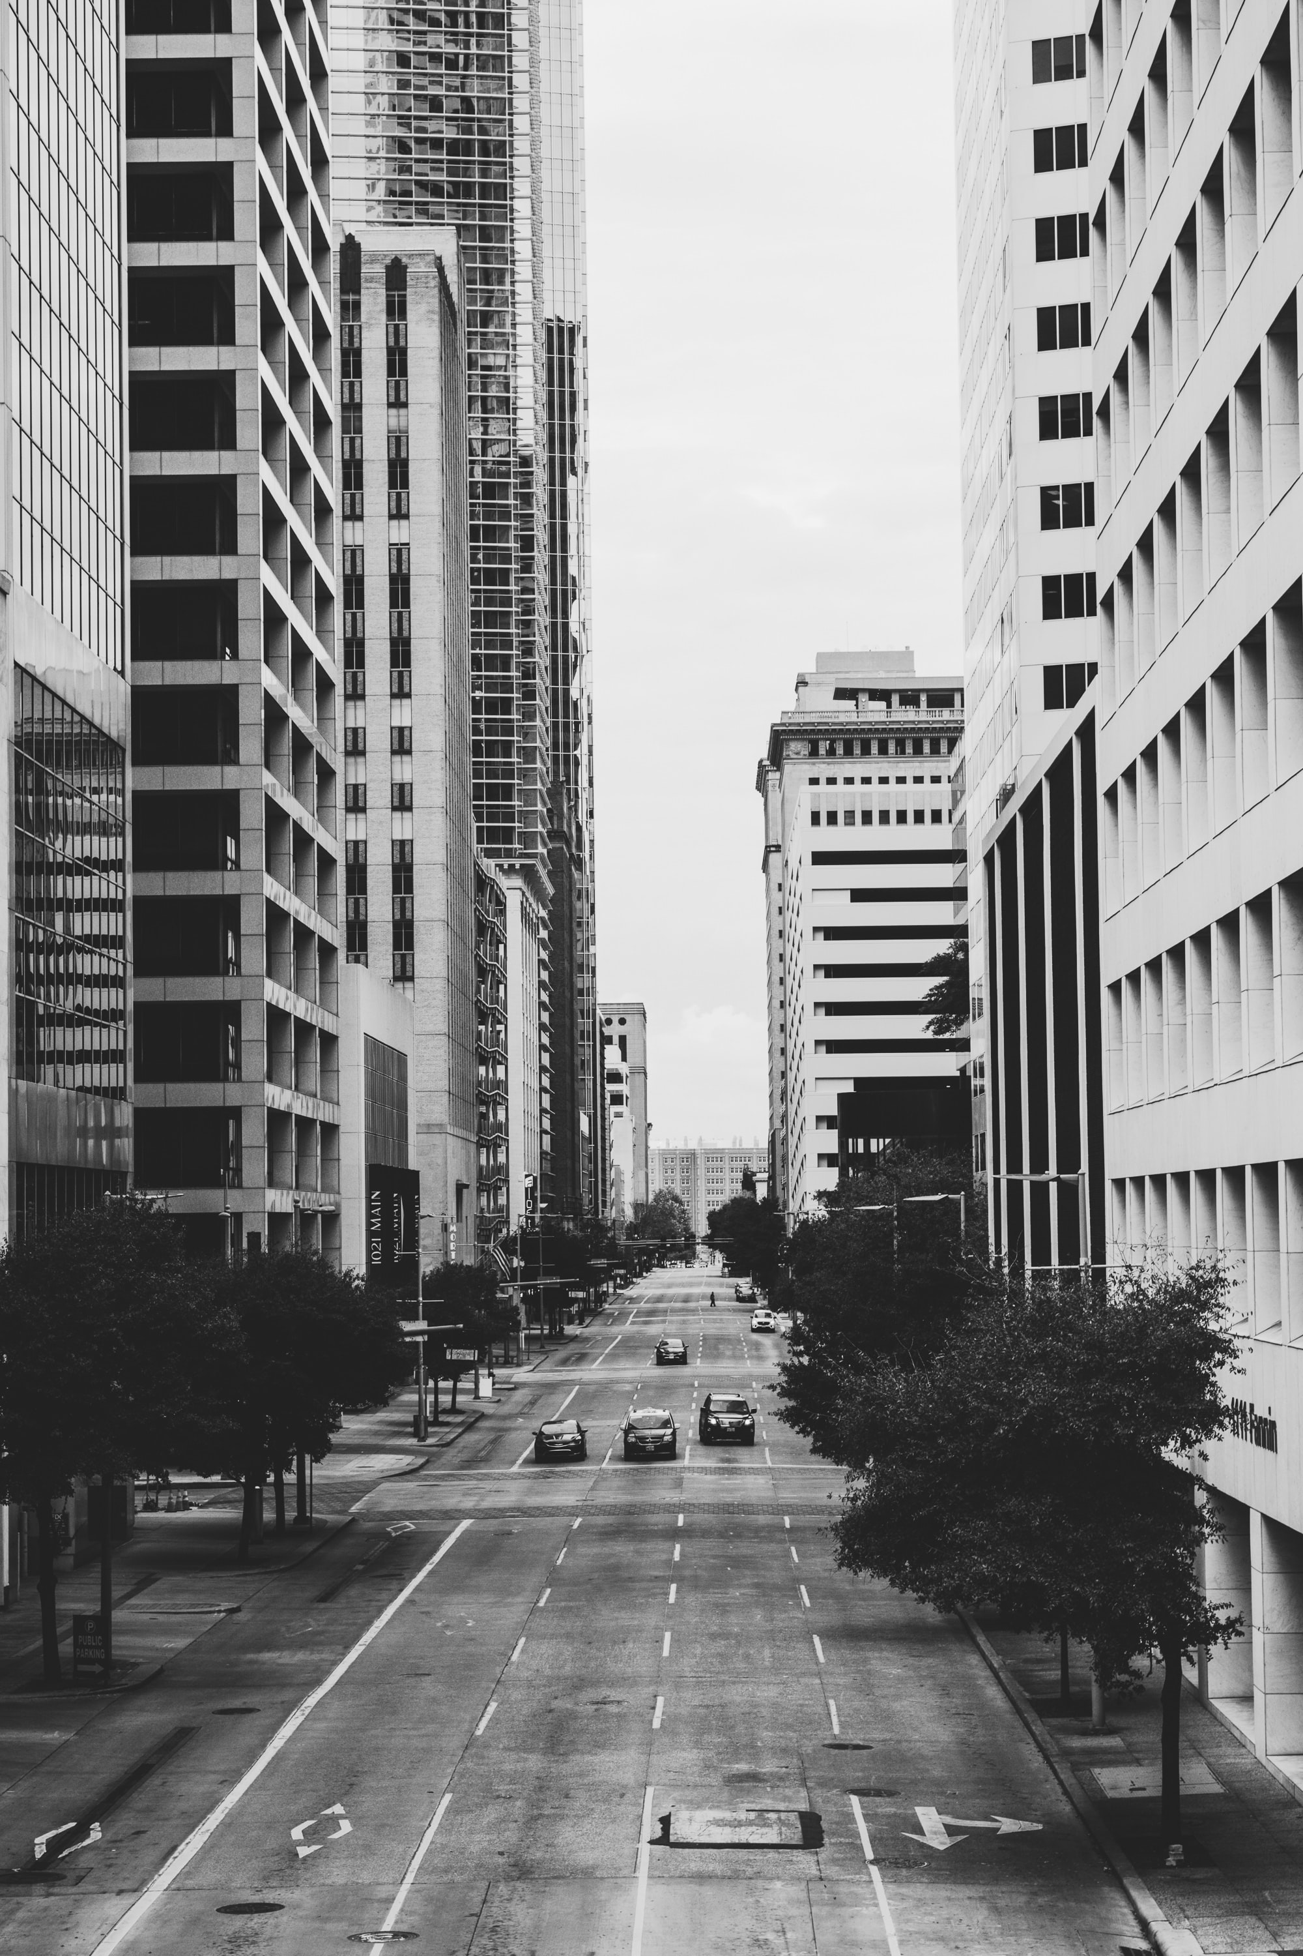
Presentation
Introduction
Target Audience
Data Overview
Methodology
Kmeans Clustering
Conclusion

Slide 4

Introduction
The objective of this project is to use Foursquare location data and regional clustering of venue information to determine which neighborhoods are 'similar' in term of venues. Through this project, we will cluster the neighborhoods in Houston to get this information

Slide 5
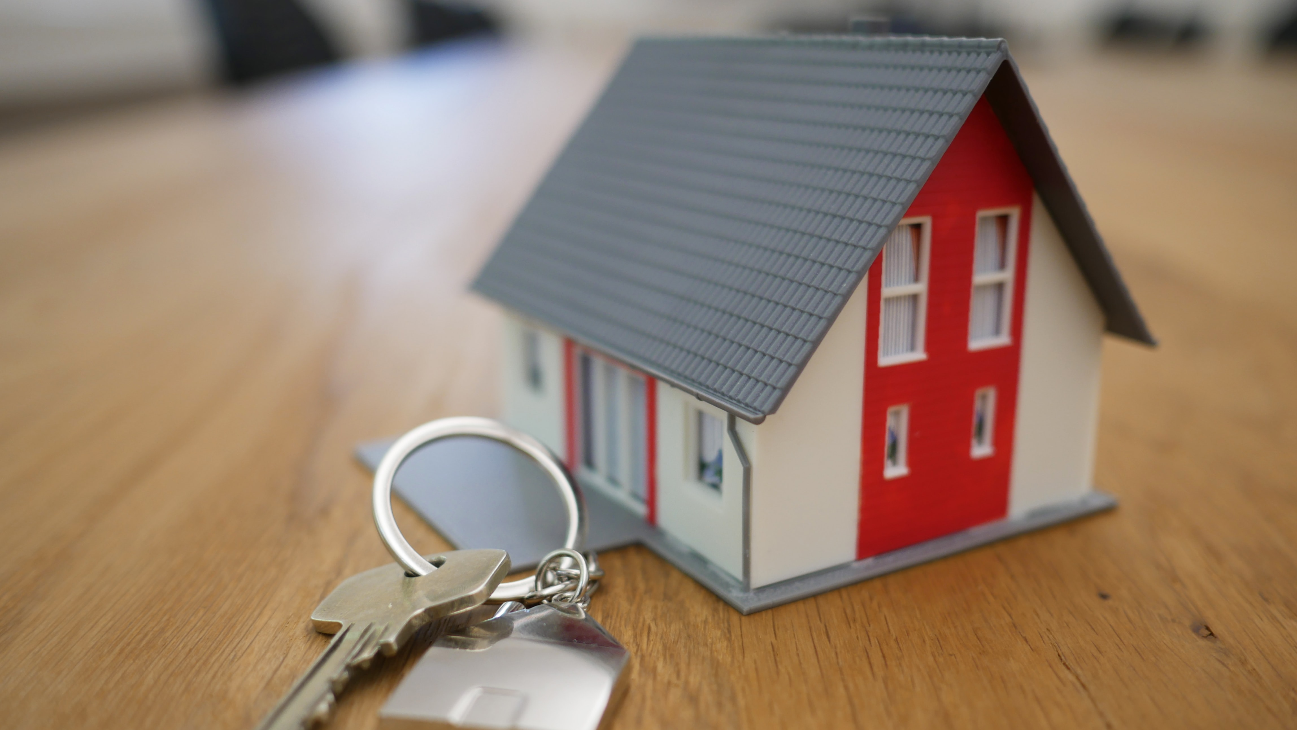
2.Target Audience
This project is aimed towards real estate agents or company or household who desire to move to another neighborhood. The analysis will provide vital information that can be used by the target audience about the neighborhood.

Slide 6
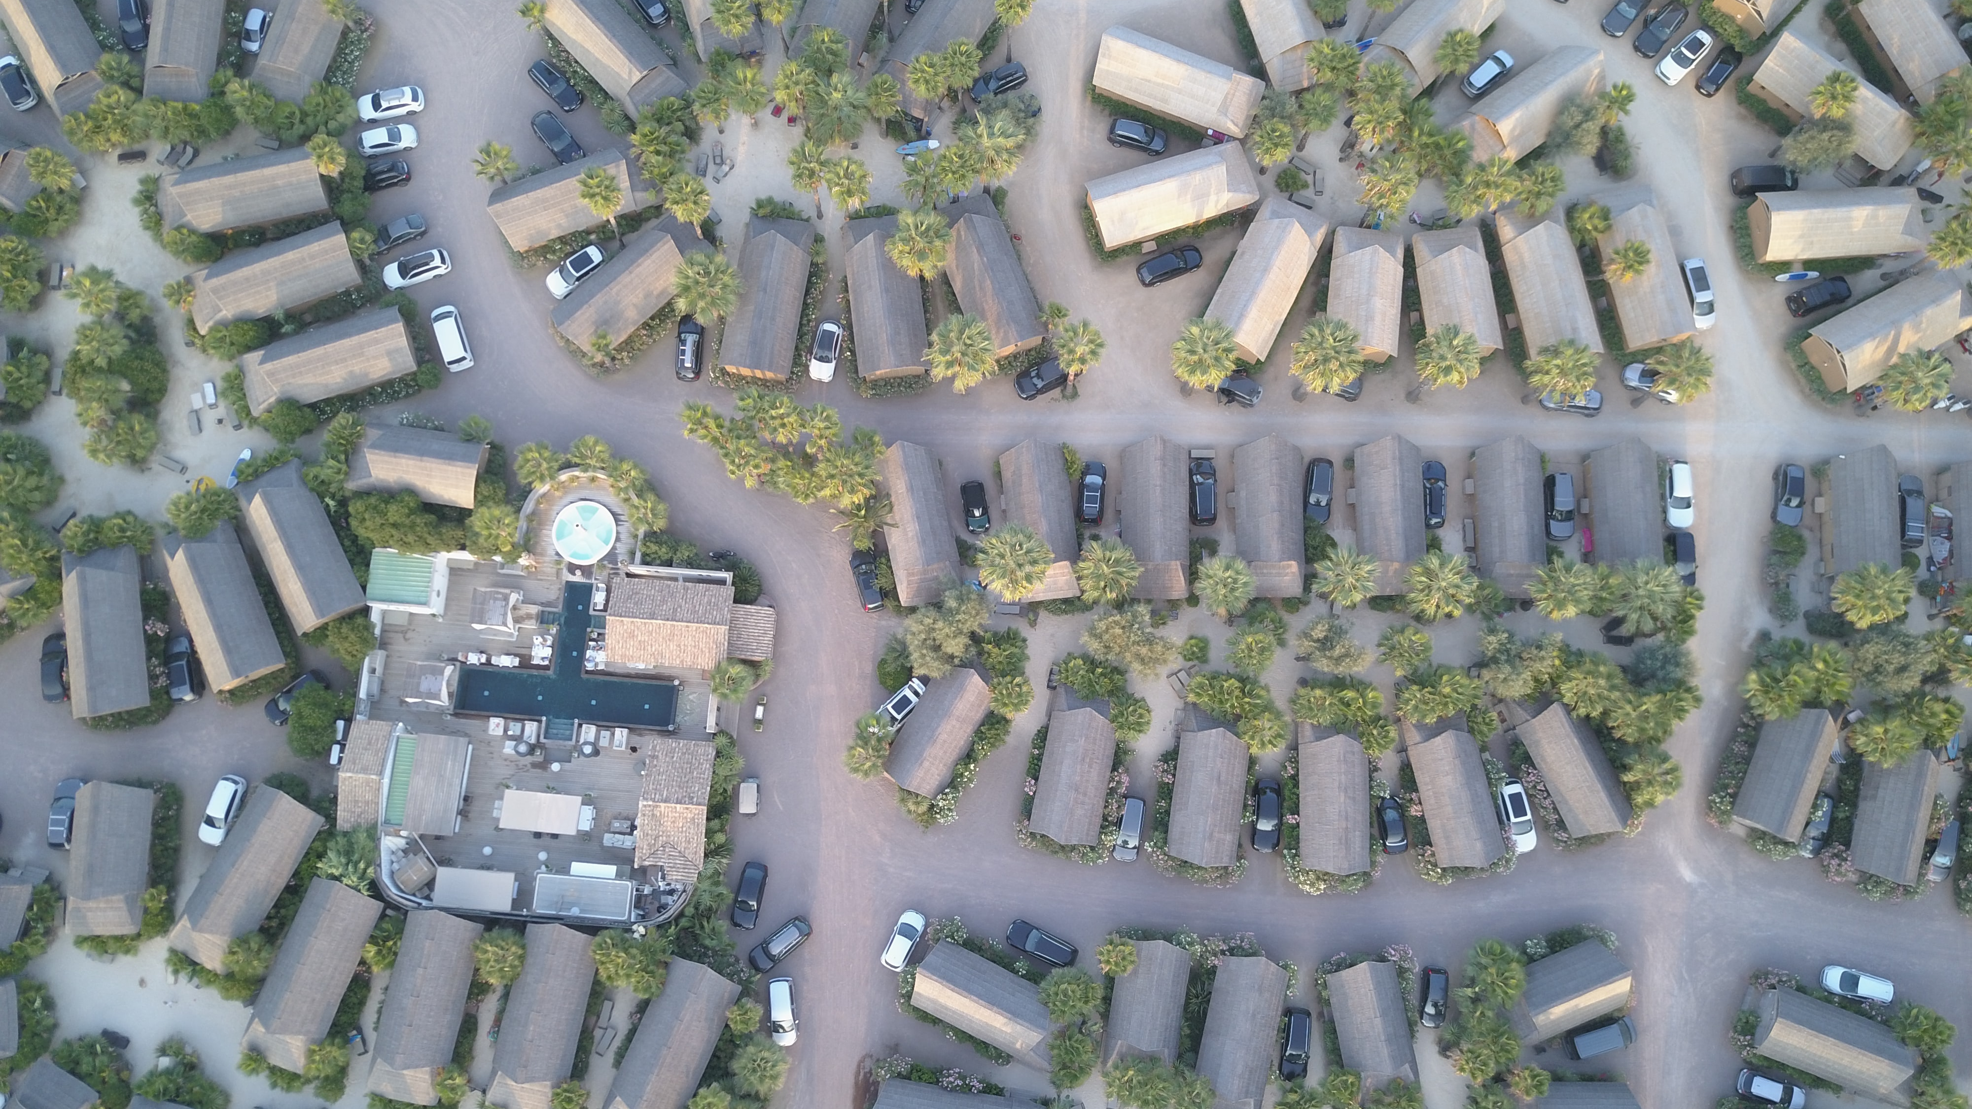
3.Data Overview and acquisition
To create this projects we need 3 sources:
Name of the neighborhoods
Location of each neighborhoods
Venues in the neighborhood

Slide 7
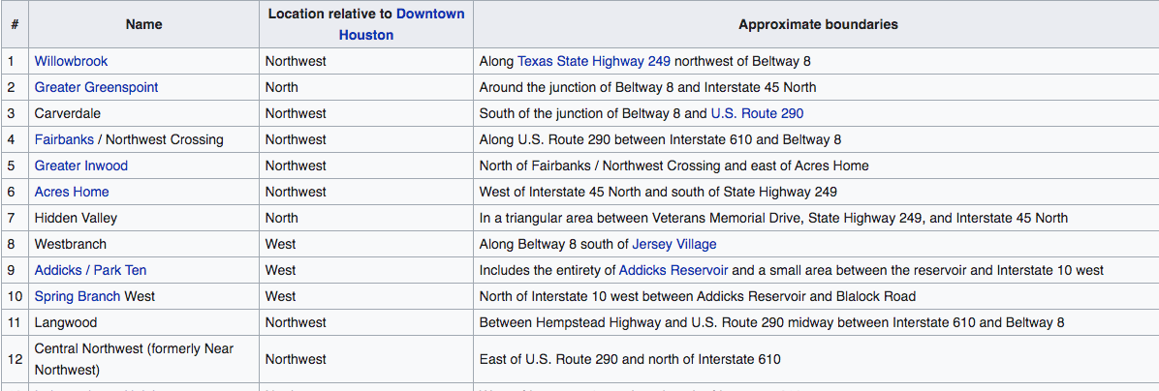
Name of neighborhoods
On wikipedia we can fin an accurate list of the name of the neigborhoods in Houston
https://en.wikipedia.org/wiki/List_of_Houston_neighborhoods

Slide 8
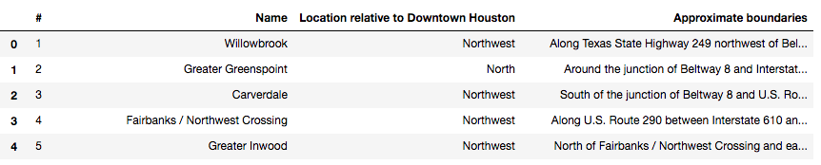
Webscape wikipedia
To use this information we need to extract, clean and processs the data to put it in a dataframe

Slide 9

The location of Neigborhood
We need to associate each neighborhood to his location (latittude, longitude)
To get the location we will use geopy, we will put the name of the neigborhoods or a central location in the neighborhood to get the coordinate

Slide 10
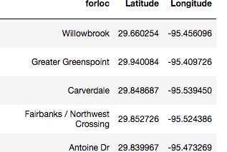
Result in our dataframe

Slide 11
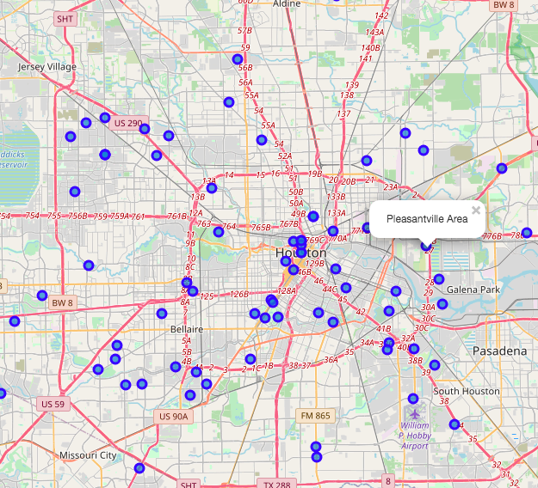
Let’s visualize our neighborhood in a map using the librairy Folium

Slide 12
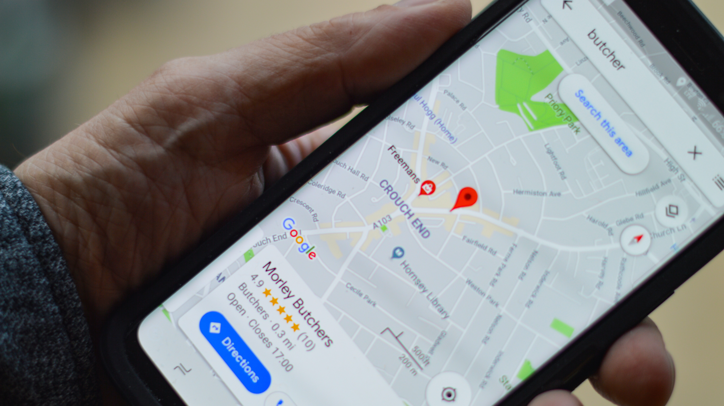
The venues in the neighborhoods
To get the data we will use the Foursquare API which is the most trusted, independent location data platform for understanding how people move through the real world.
The foursquare API is used for Apple maps, Uber, Snapchat, Twitter and many others

Slide 13
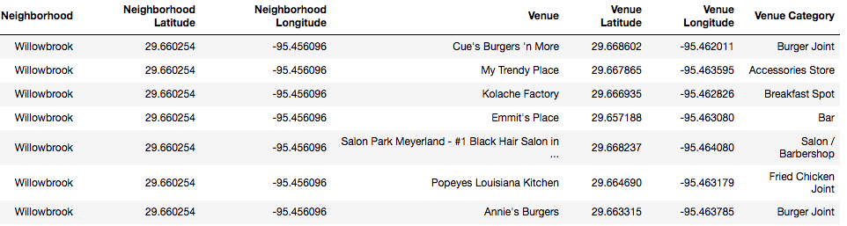
Our datframe after integration of 3 sources
We need to integrate the third source to our dataframe
Clean and process our data
We now have a detailed daframe with the name of neighborhood, location and venues arround the center of the neighborhood

Slide 14
4.Methodology
4.1 Data Cleansing
4.2 Data Exploration
4.3 Machine Learning methodology

Slide 15
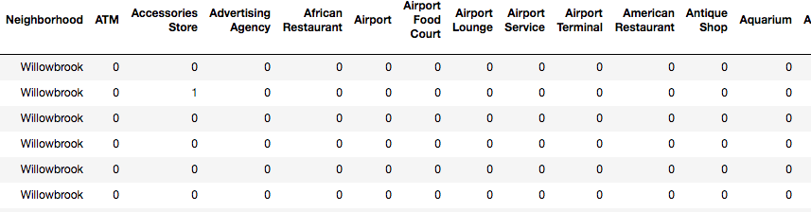
4.1Data Cleansing
To analyze the data we performed a technique in which Categorical Data is transformed into Numerical Data for Machine Learning algorithms. This technique is called One hot encoding. For each of the neighborhoods, individual venues were turned into the frequency at how many of those Venues located in each neighborhood.

Slide 16
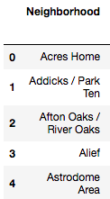
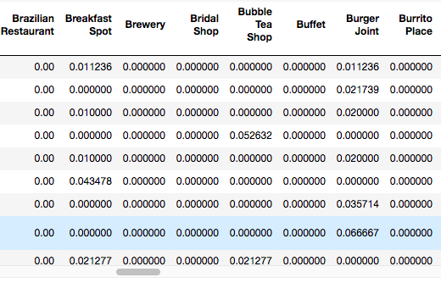
4.2Data exploration
For each neighborhood, we calculate the frequency of each venue as we can in this sample of our dataset

Slide 17
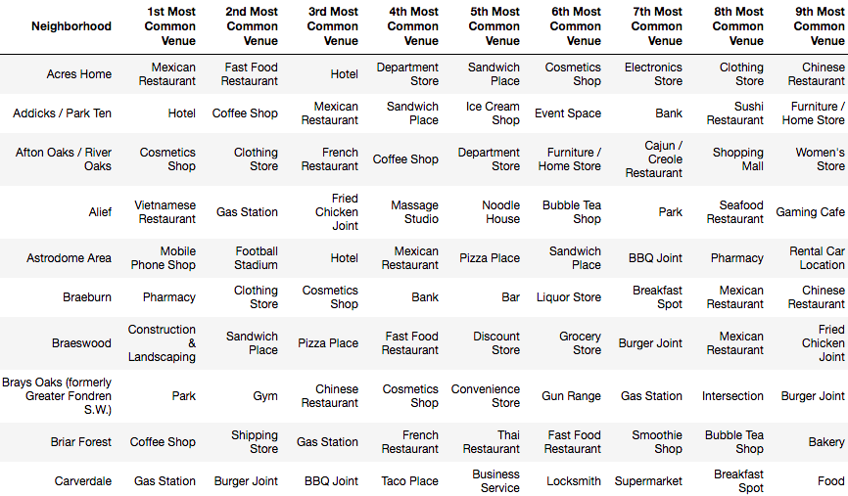
10 most common venues per Neighborhoods
For each neighborhood according to the frequency we get the most common venues

Slide 18
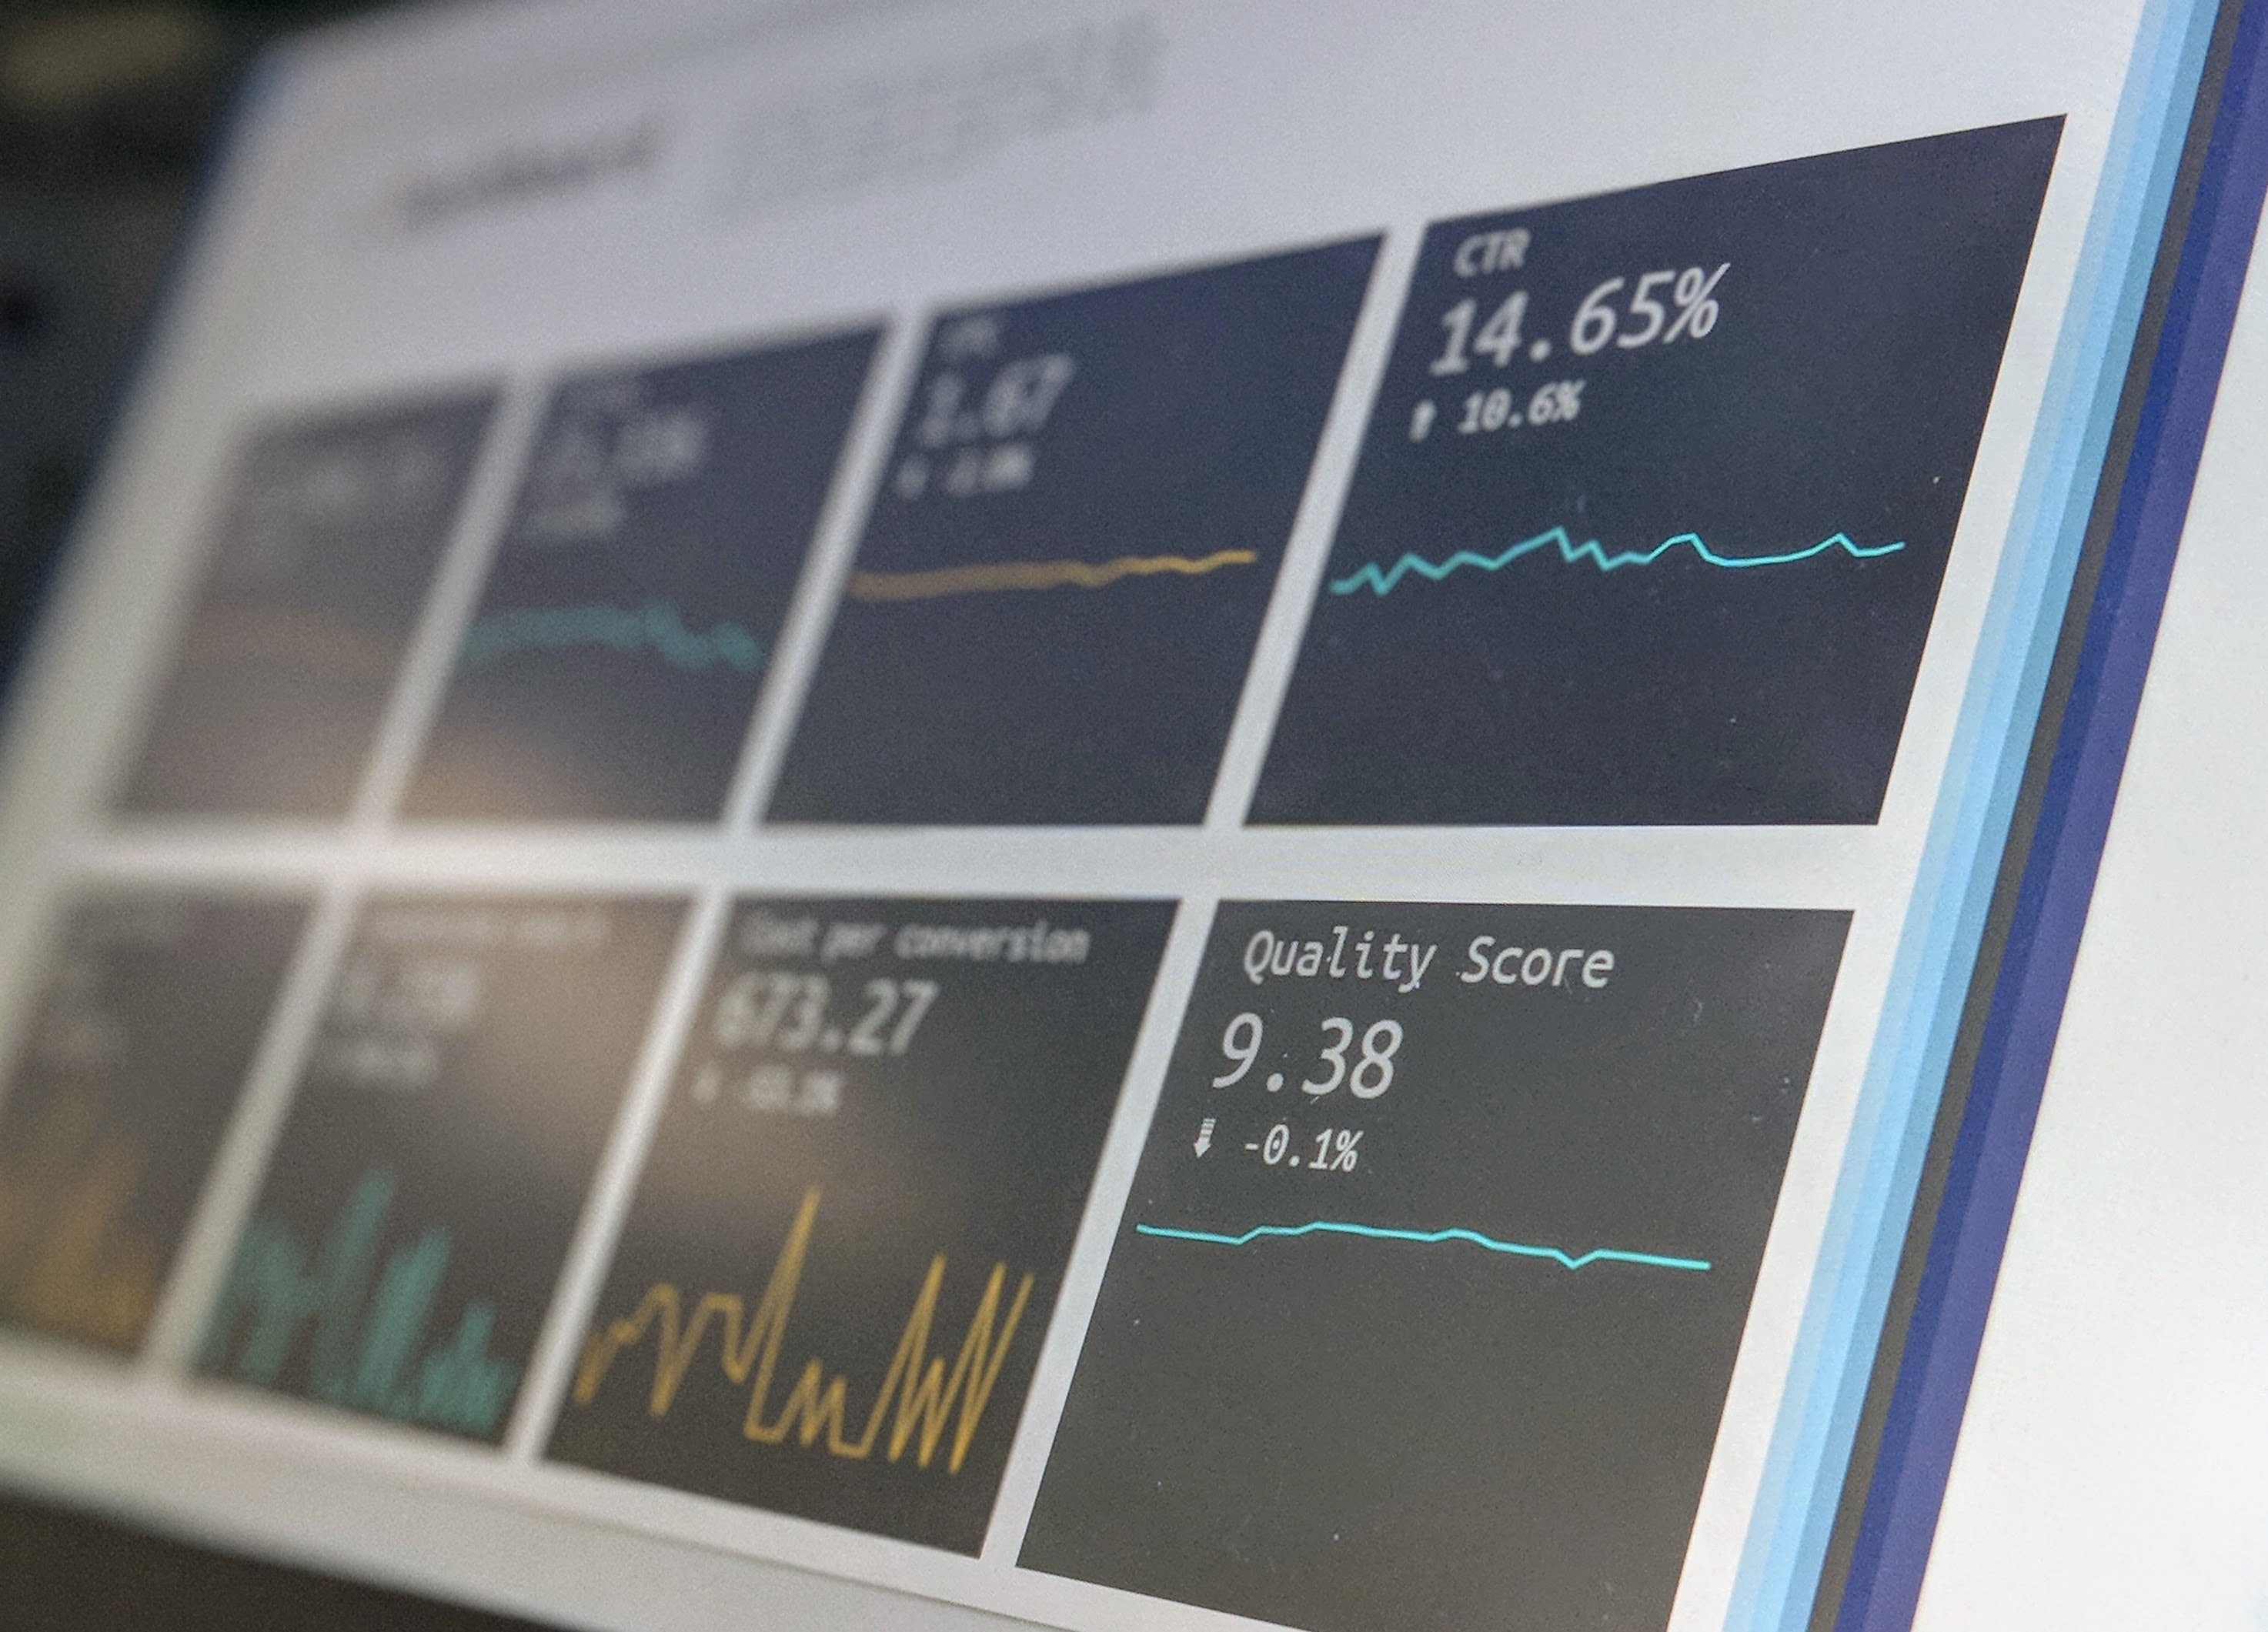
4.3 Machine Learning Methodology
We need Find a way to group neighbourhoods according to their similarities
The Kmeans seem to be a good way to get the expected results let’s explore it the next section

Slide 19
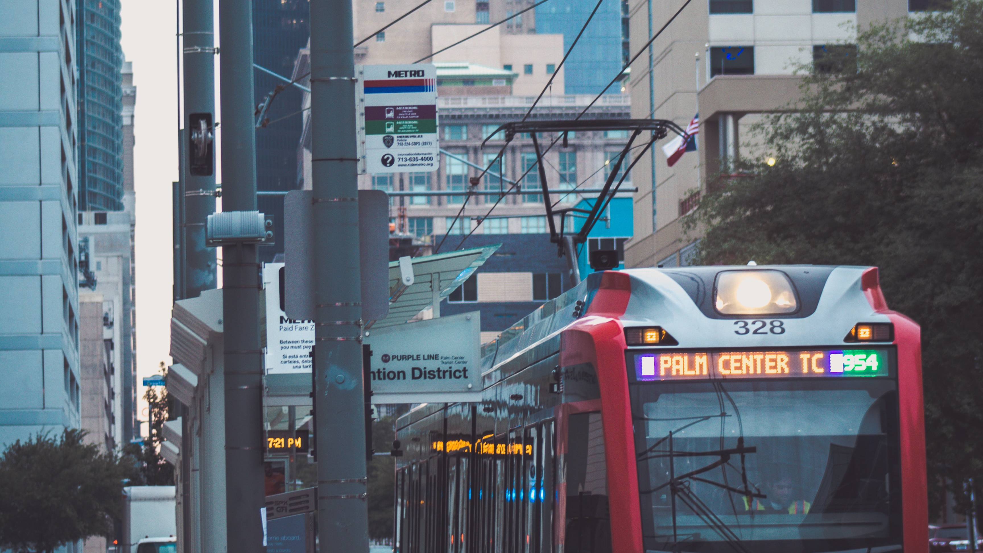
5.Kmeans Clustering
5.1 Kmeans definition
5.2 Optimization of our model
5.3 Description of our cluster

Slide 20
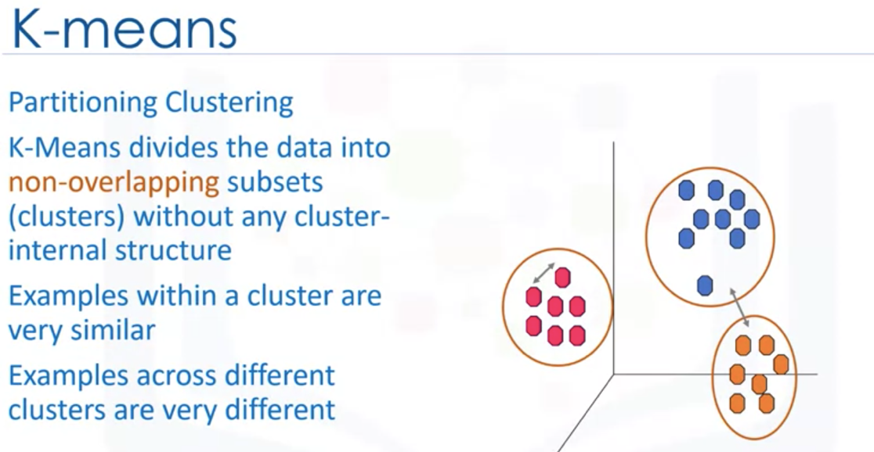
5.1 What is the Kmeans clustering ?
Source IBM coursera class project capstome

Slide 21
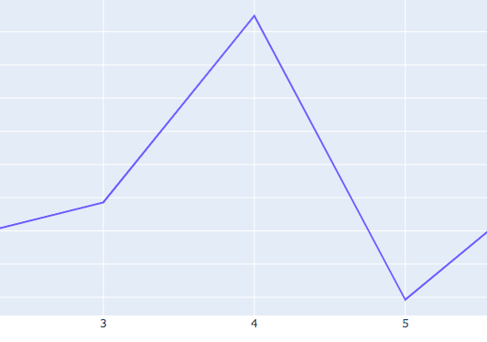
5.2 Optimization of our model: silhoutte score
Definition:The Silhouette Coefficient is calculated using the mean intra-cluster distance (a) and the mean nearest-cluster distance (b) for each sample.
It’s presented as the most accurate method to optimize a Kmeans according to the book “hands-on)Machine Learning wih scikit Learn, Aurélien Géron”
We get an optimum for 4 clusters

Slide 22
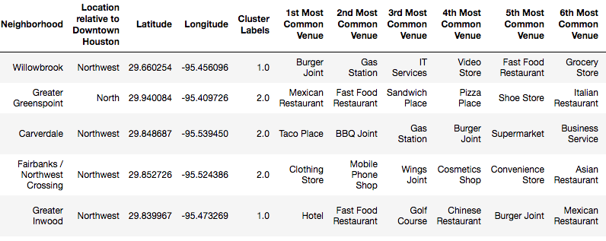
5.3 Description of our clsuer
After clusering we createds a column with the cluster corresponding to the neighborhoods

Slide 23
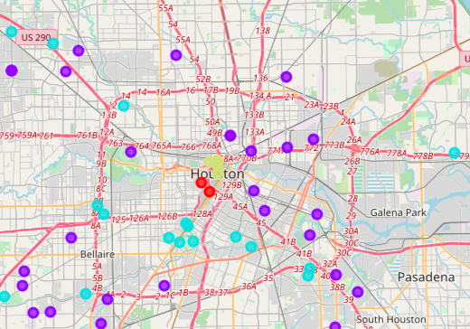
Vizualisation on Folium of our results
Each collor on this interractive map represent the cluster
We have 4 clusters:
Red: Cluster 0 Blue: cluster 1 Bluesky: cluster 2 Green: cluster 3

Slide 24
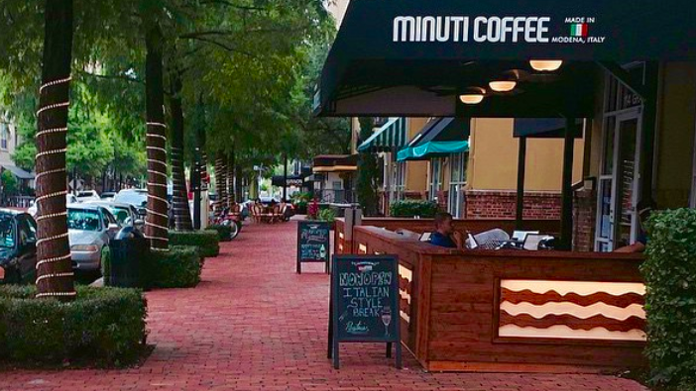
Cluster 0
High frequency of coffee , bar and Mexican restaurant Vietnamese infrastructure
We can see notify high density of Gym
Most of the neighborhoods are locate in the center of Houston

Slide 25
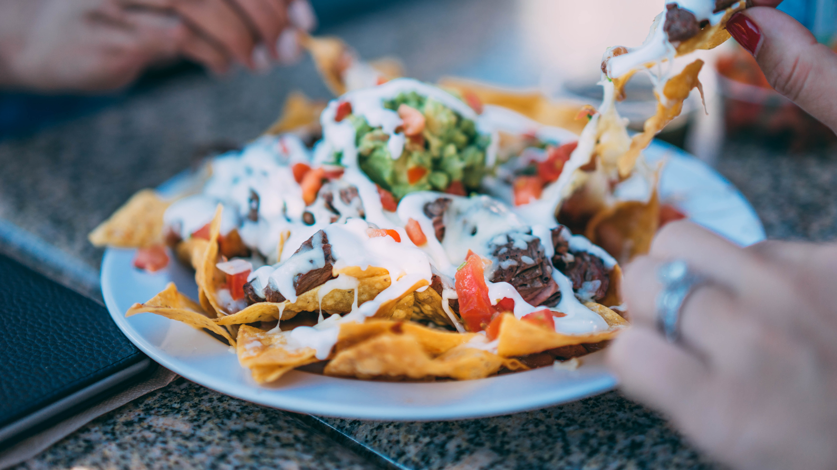
Cluster 1
Lot of green spaces with a high density of park, a lot of fast foods and construction an landscaping
Highest frequency of mexicans restaurants bewteen all the clusters

Slide 26
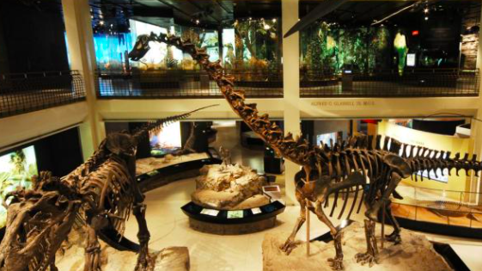
Cluster 2
Lot of italian restaurants and pizza place
High frequency of culueral acitivties like museum, zoo and art gallery
High frequency of clothes and cosmectics store

Slide 27
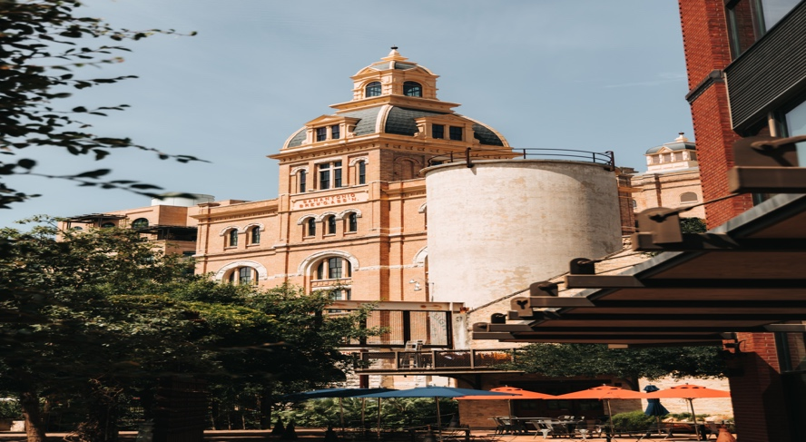
Cluster 3
High frequency of Southern / Soul Food Restaurants, bar, concert hall
Highest concentration of hotel

